Slide 1

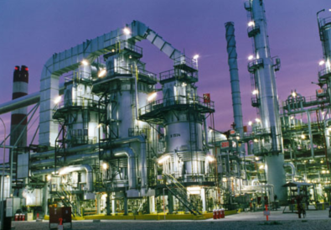
Application fields for in classical industrial-analytics industry
Andreas Wygrabek
Data Scientist
eRum 2016

Slide 2
What is this talk about?
Objectives
Differentiation of data science and classical analytics tasks
in industry
Application scenarios for R in industry
Reveal the potential of R in scenarios of classical analytics
Notes:
Im Uhrzeigersinn aber der Glühbirne: Innovativ + Sexy + machine learning + predictive + new business + uncertanty + programming language like R & python + complex

Slide 3
Representative applications of ...
Data Science

Slide 4






Data Science | Energy Forecast
Data Science
Analytic
Metrological Data
Weather Forecast

Slide 5


Data Science | Predictive Maintenance
Data Science
Analytic
Sensor Data
Machine Failure Predictions

Slide 6

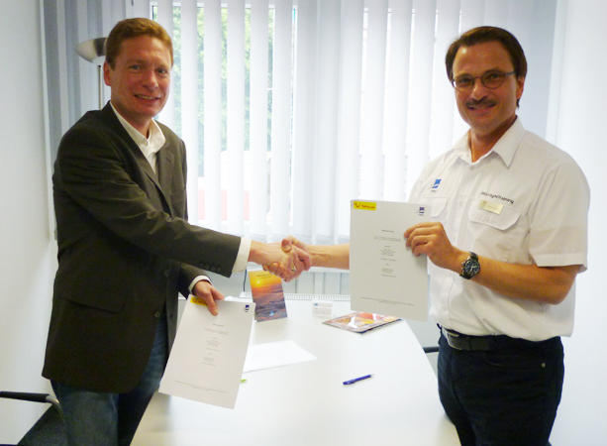
Data Science | Scoring
Data Science
Analytic
Customer Data
Conversion Probability

Slide 7
Representative applications of ...
Classical_Analytics

Slide 8







Classical Analytics | Incoming Goods Inspection
Analytic
Analytic
Acceptance Sampling
Results (Acceptance, Rejection)

Slide 9
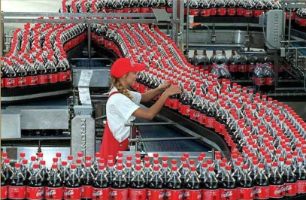
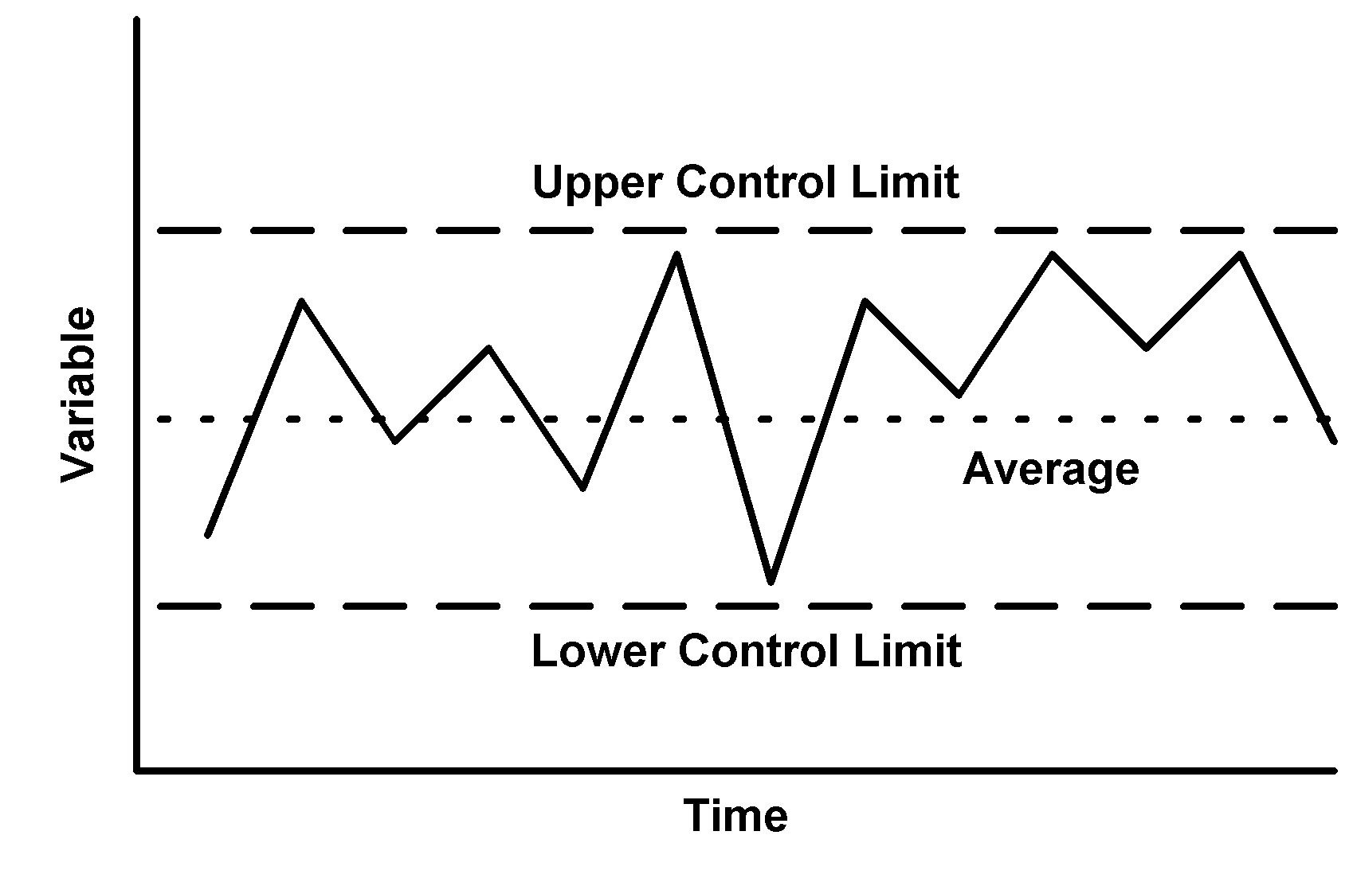
Classical Analytics | Statistical Process Control
Analytic
Analytic
Sampling Data
Process Charts

Slide 10
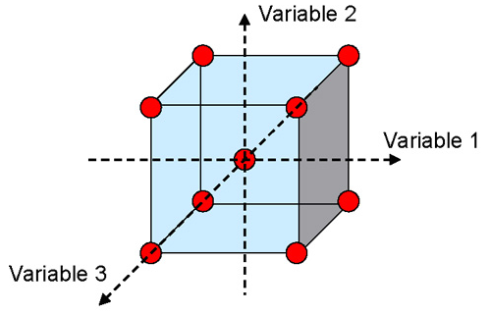
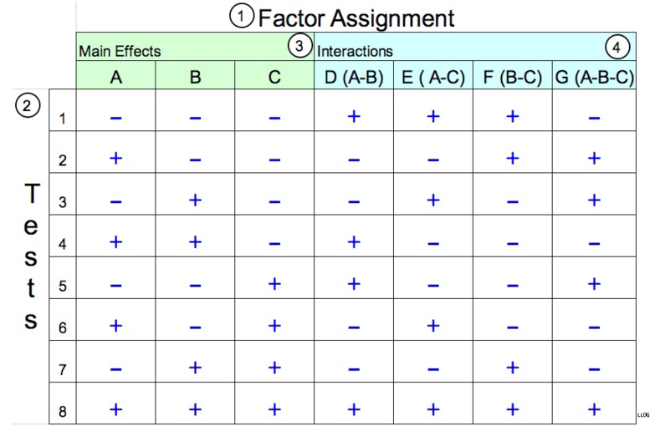
Classical Analytics | Design of Experiments
Analytic
Analytic
Sampling Data
Cause-Effect-Relations

Slide 11
How do the applications of data science and
classical analytics in industry differ?

Slide 12
Analytics and Data Science | Methodology
Analytics
Data Science
Statistics
Descriptive Statistics
Mean
Range
Correlation
Variance
…
Inference Statistics
Testing
Exploratory Data Analysis (Data Science Methods)
Clusteranalysis
Forecasts
Mu
Sigma
Regression
Predictive
alpha/beta
Confidence
PCA
Algorithms
Deep Learning
Normal Distribution
Probabilities
Modelling
Time Series
Data-Mining
…
Classification
…
Notes:
Im Uhrzeigersinn aber der Glühbirne: Innovativ + Sexy + machine learning + predictive + new business + uncertanty + programming language like R & python + complex

Slide 13


Analytics and Data Science | Project Management
Analytic: Traditional PM
Solution known
Standardized Issues
Ressource estimation
Data Science: Agile
Interative solution
Individual Issues

Slide 14
Analytics and Data Science | Data
Analytic: Data is certain
Data certainly contains
all required informations
Data Science: Data is uncertain
Often it is not certain that
the data contains the
required information

Slide 15
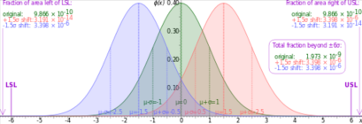

Analytics and Data Science | Difficulty
Analytic is complicated
- Experts will solve the issue
Data Science is complex
- No guarantee

Slide 16


Analytics and Data Science | Location
Analytic:
Quality Management
Production
Data Science:
IT
Business Intelligence
Data Science Lab

Slide 17


Analytics and Data Science | Implementation
Analytic: Choosing the right tool
Data Science: Proof of Concept

Slide 18
How capable is R to solve the issues which are
typical in industry?

Slide 19
Classical_Analytics
in
Incoming Goods Inspection
Sampling
AcceptanceSampling
Statistical Process Control
spc
qcc
IQCC
qualityTools
SixSigma
DoE
CRAN Task View: Design of Experiments (DoE) &
Analysis of Experimental Data
Most used package: agricolae
Reporting
knitr
shiny
interfaces to external
software

Slide 20
Mind the gap
R is powerfull – all the tasks mentioned can be solved
R is free
R is able to report
The need for new tools in classical analytics is growing

Slide 21
What are the reasons?
Qualification
Old processes
Established Software

Slide 22
To Do´s
Bring R-Developers closer to QM and production
Upskill engineers in R
Further package development (AQL, ISO 2859, ISO 3951)
Create stable R environments

Slide 23






The Data Science Specialists.
eoda GmbH
Universitätsplatz 12
34127 Kassel - Germany
www.eoda.de/en
info@eoda.de
+49 561 202724-40
@eodaGmbH
blog.eoda.de
@eodaGmbH
eodaGmbH

